Slide 1

INTRODUCTION TO OPENCV HANDS-ON WORKSHOP IN PYTHON
SAI KAMAL korlakuntasaikamal10@gmail.com
Computer vision scientist

Slide 2
OVERVIEW
OpenCV is the most popular Image Processing and Computer Vision library
Free for both academic and commercial use
Very easy to learn
It has C++, C, Python and Java interfaces and supports Windows, Linux, Mac OS, iOS and Android
Designed for computational efficiency and with a strong focus on real-time applications
Lot of documentation online

Slide 3
RESOURCES
Official site: http://opencv.org/

Slide 4
WORKSHOP OUTLINE (TOPICS)
Loading, showing and saving images
Histograms and Histograms equalizations
Gamma correction
Smoothing, sharpening and noise removal
Morphological operations (erosion, dilation)
Edge detection
Transformation
Adaptive thresholding
And finally: Document scanner

Slide 5
LOADING, SHOWING AND SAVING IMAGES
Loading: image = cv2.imread(“file_name",0)
(0 means Gray Scale, no number will use original image’s colors)
Displaying: cv2.imshow(“some headline",image)
(Usually followed by: cv2.waitKey(0) so the image will not close immediately)
Saving: cv2.imwrite(“file_name",image)
Code: load_and_display.py

Slide 6
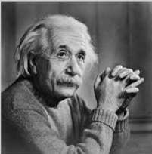
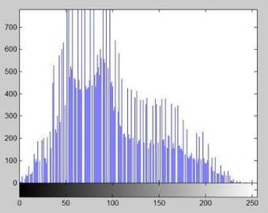
HISTOGRAMS AND HISTOGRAMS EQUALIZATIONS
Histogram: Showing how many pixels have a certain intensity (between 0 and 255) in a picture.

Slide 7
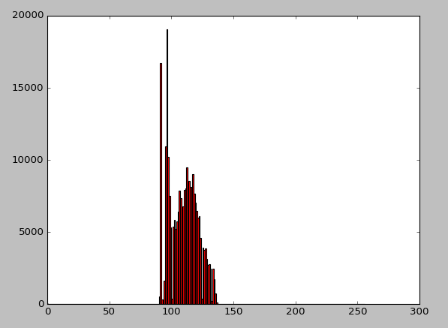
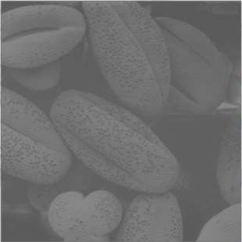
HISTOGRAMS AND HISTOGRAMS EQUALIZATIONS (CONT.)
“Good” pictures have their histograms nearly equally spread over the entire range.
However in a lot of pictures this is not always the case

Slide 8
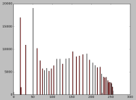
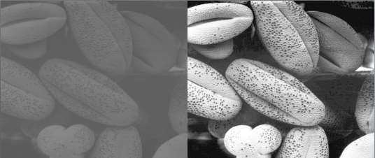
HISTOGRAMS AND HISTOGRAMS EQUALIZATIONS (CONT.)
Solution: Histogram equalization
(see theoretical equations here:
http://www.math.uci.edu/icamp/courses/math77c/demos/hist_eq.pdf)
With openCV: image2 = cv2.equalizeHist(image)
Code:
load_and_display.py

Slide 9
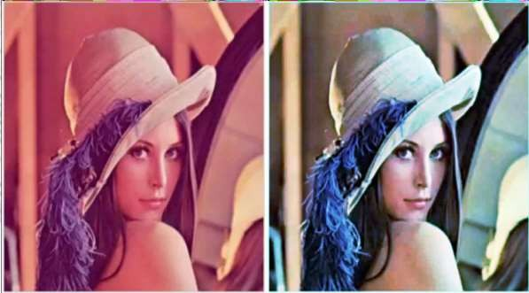
HISTOGRAMS AND HISTOGRAMS EQUALIZATIONS (CONT.)
On color images:
Split the color channels with: b,g,r = cv2.split(image)
Equalize each channel separately
Merge the channels with: image2 = cv2.merge((b,g,r))
Code: equalizing_color_images.py

Slide 10
GAMMA CORRECTION
Sometimes images are too dark, or too bright
Fixing it with just adding/substracting intensities produses bad results
Solution: Gamma correction
Transform intensities from [0,255] to [0,1] with a LUT (look up table)
Apply this to all pixels: O = I ^ (1 / G) (G is the gamma value, higher = brighter)
Transform back to [0,255] with LUT

Slide 11
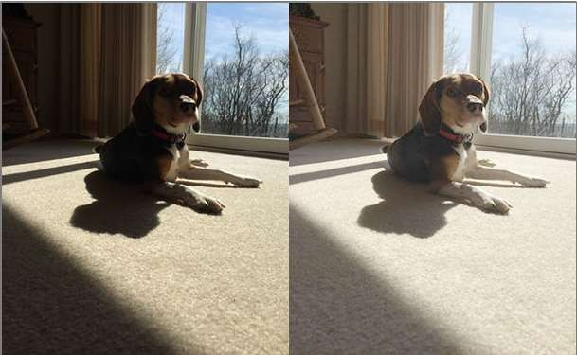
GAMMA CORRECTION (CONT.)
In openCV:
def adjust_gamma(image, gamma=1.0):
invGamma = 1.0 / gamma
table = np.array([((i / 255.0) ** invGamma) * 255
for i in np.arange(0, 256)]).astype("uint8")
return cv2.LUT(image, table)
adjusted = adjust_gamma(original, gamma=2)
Code:
gamma_correction.py

Slide 12

SMOOTHING, SHARPENING AND NOISE REMOVAL
Smoothing is done by applying a simple filter to the picture, for
example (3x3 kernel):
Each pixel is averaged with its 8 neighbors.
Gaussian smoothing : Each pixel is averaged (with Gaussian weights) with its 8 neighbors.
Median smoothing: Each pixel is gets the median value of him and its 8 neighbors.

Slide 13

SMOOTHING, SHARPENING AND NOISE REMOVAL (CONT.)
In openCV (5x5 kernel:
average_blur = cv2.blur(image,(5,5))
gaussian = cv2.GaussianBlur(image,(5,5),0)
median = cv2.medianBlur(image,5)
Code:
smoothing _and_cleaning.py

Slide 14
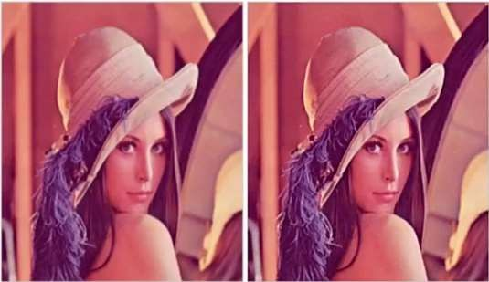
SMOOTHING, SHARPENING AND NOISE REMOVAL (CONT.)
Sharpening: Done be subtracting from the picture, a Gaussian
blurred version of itself
In openCV:
gaussian = cv2.GaussianBlur(image,(9,9),10)
sharpened = cv2.addWeighted(image,1.5,gassuian,-0.5,0)
Code:
smoothing _and_cleaning.py

Slide 15
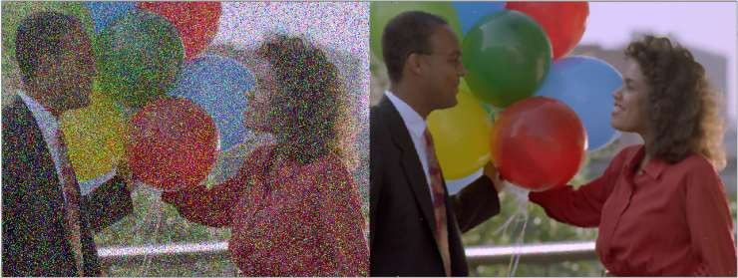
SMOOTHING, SHARPENING AND NOISE REMOVAL (CONT.)
Some types of noise (especially Salt & Pepper) can be removed by using a median filter (with a small kernel)
Code:
smoothing _and_cleaning.py

Slide 16
MORPHOLOGICAL OPERATIONS (EROSION,
DILATION)
Morphological transformations are some simple operations
based on the image shape.
It is normally performed on binary images.
It needs two inputs, one is our original image, second one is called structuring element or kernel which decides the nature of operation.
Two basic morphological operators are Erosion and Dilation
Erosion: Match the value of all pixels in the kernel to the one with the minimum value .
Dilation: Match the value of all pixels in the kernel to the one with the maximum value .

Slide 17
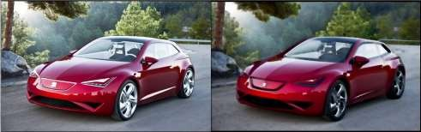
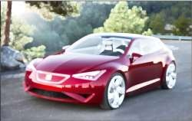
MORPHOLOGICAL OPERATIONS (EROSION,
DILATION) (CONT.)
On openCV (with kernel of 5x5):
kernel = np.ones((5,5),np.uint8)
Code:
eroded = cv2.erode(image,kernel) dilated = cv2.dilate(image,kernel)
Original
erosion_dialation_inversion.py
Eroded
Dilated

Slide 18
EDGE DETECTION (CANNY)
Canny Edge Detection is a popular edge detection algorithm. It was developed by John F. Canny in 1986
Does the following steps:
Cleaning the image by blurring it.
Finding Intensity Gradient of the Image:
Using Sobel to find intensities of gradients in x and y directions creates a
picture of gradient intensities.
Non-maximum Suppression:
Suppress (set to 0) all pixels which are not a local maximum, to thin the edges.
Hysteresis Thresholding:
Any edges with intensity gradient more than maxVal are sure to be edges and those below minVal are sure to be non-edges, so discarded. Those who lie between these two thresholds are classified edges or non-edges based on their connectivity. If they are connected to “sure-edge” pixels, they are considered to be part of edges. Otherwise, they are also discarded

Slide 19
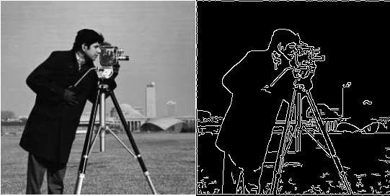
EDGE DETECTION (CANNY) (CONT.)
In openCV:
edges = cv2.Canny(img,100,200)
(The two numbers are min-val and max-val)
Code: edge_detection.py

Slide 20
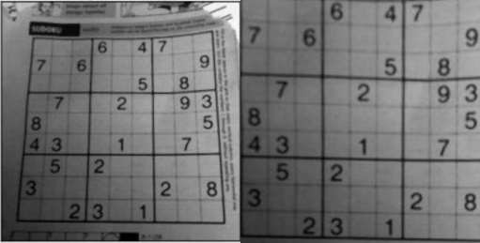
TRANSFORMATION
Transformation: Reshape the picture such that is gets 4 co-ordinates from the original picture and 4 new coordinates, and trasnforms the picture so the 4 points (and all points between them) will match the new ones.
In openCV :
M = cv2.getPerspectiveTransform(pts1,pts2) dst = cv2.warpPerspective(img,M,(257,259))
(The last two numbers are the size of the new image)
Code: trasnformation_and_adaptive_threshold.py

Slide 21
ADAPTIVE THRESHOLDING
Thresholding: Set pixel to 255 if it’s intensity is above a
certain threshold, otherwise set to 0.
Simple thresholding: Threshold is constant for the entire picture.
Adaptive thresholding: Different thresholds for different regions of the same image
Mean: Threshold value is the mean of neighborhood area.
Gaussian: Threshold value is the weighted sum of neighborhood values where weights are a Gaussian window.

Slide 22
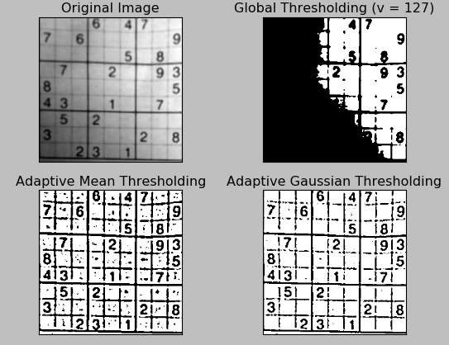
ADAPTIVE THRESHOLDING (CONT.)
In openCV:
ret,th1 = cv2.threshold(dst,127,255,cv2.THRESH_BINARY)
th2 = cv2.adaptiveThreshold(dst,255,cv2.ADAPTIVE_THRESH_MEAN_C,cv2.THRESH_BINARY,11,2) th3 =
cv2.adaptiveThreshold(dst,255,cv2.ADAPTIVE_THRESH_GAUSSIAN_C,cv2.THRESH_BINARY,11,2)
Code: trasnformation_and_adaptiv e_threshold.py

Slide 23
DOCUMENT SCANNER
Steps:
Edge detection
Contour (find borders
Transformation (So only document remains)
Adaptive thresholding
Code: scan.py

Slide 24
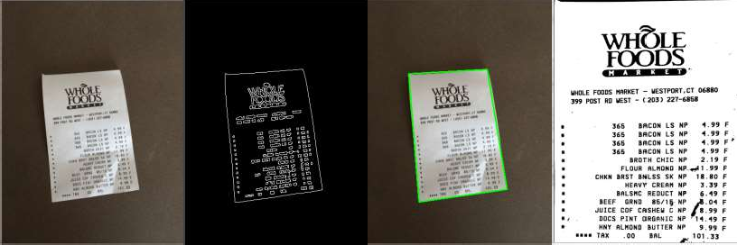
DOCUMENT SCANNER (CONT.)
Original Edge detection Contour
Transformation and Thresholding

Slide 25
Thank you!

